Slide 1
CST 370 – ADVANCED ALGORITHMS
HW1, HW2, Exam 1 Reflection

Slide 2
CS Department Survey
The CSUMB CS Department would like everyone to fill out this survey:
https://docs.google.com/forms/d/1FqyWKzMioX-fnufcflnEbkqrTjOn0ntOTyQk9V41les/
Notes:
Complete trees are nice because you can also represent complete trees with an array!
When a complete tree is stored like this, the root is at index 0, the left child is at 2*i + 1 and the right child is at 2*i + 2
for any node a i, it’s parent is at floor(i-1/2)

Slide 3
Objectives
Explain how to redo past quizzes for credit.
Identify one to two topic/concepts from assessments so far that you feel comfortable and proficient in.
For each missed problem on hw1, hw2, and the midterm. Identify the misconception that caused your mistake.
Explain the course structure for the next 4-5 weeks and why we are structuring class-time this way..
Identify one action you can take to continue to succeed for the next 4-5 weeks.
Notes:
Complete trees are nice because you can also represent complete trees with an array!
When a complete tree is stored like this, the root is at index 0, the left child is at 2*i + 1 and the right child is at 2*i + 2
for any node a i, it’s parent is at floor(i-1/2)

Slide 4
Homework 1
Early Feburary
Initial Submission: 54%
Average: 57%
Median: 65%
Notes:
Another special tree is the Binary Search Tree.
everything in the left subtree is smaller than the right.

Slide 5
Homework 2
End of February
Initial Submission: 72%
Median: 90%
Notes:
Another special tree is the Binary Search Tree.
everything in the left subtree is smaller than the right.

Slide 6
Homework 2
End of February
Initial Submission: 72%
Median: 90%
We are improving how we work on homework and the quality of work we turn in!
Notes:
Another special tree is the Binary Search Tree.
everything in the left subtree is smaller than the right.

Slide 7
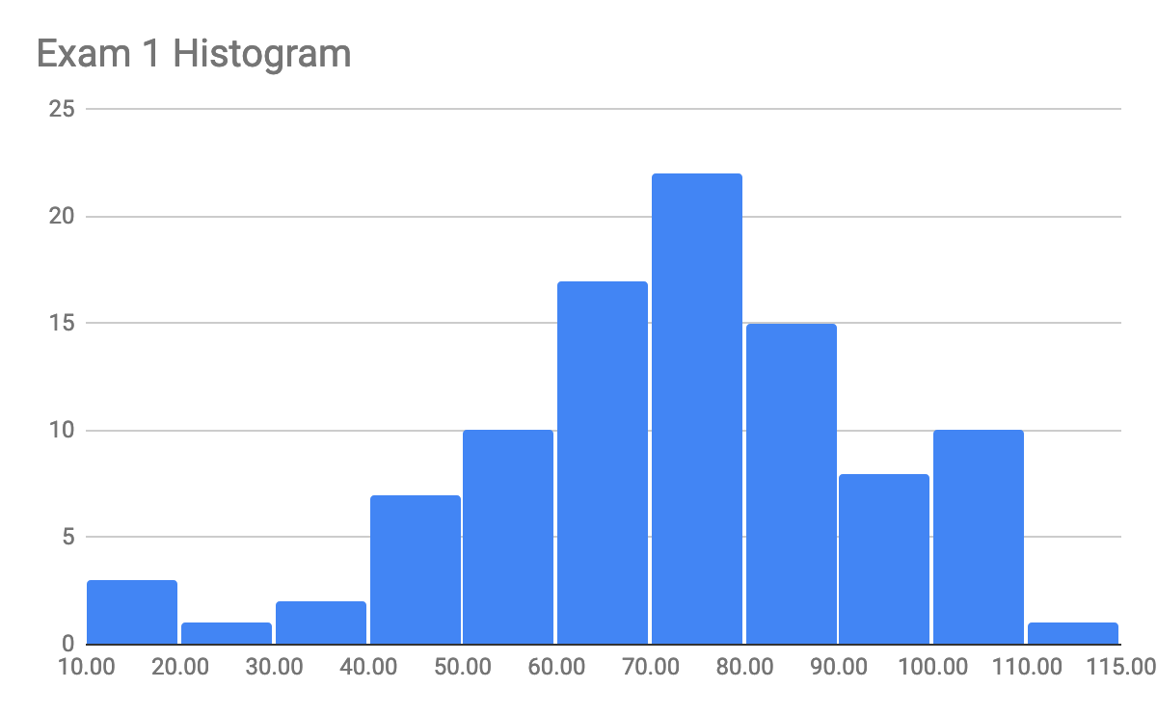
Midterm 1
End of February
Average: 71.86
Median: 72
Std. Deviation: 20.45
Notes:
Another special tree is the Binary Search Tree.
everything in the left subtree is smaller than the right.

Slide 8
In-class Quizzes & Work
Average: 81
Median: 81
Std. Deviation: 13
Notes:
Another special tree is the Binary Search Tree.
everything in the left subtree is smaller than the right.

Slide 9
In-class Quizzes & Work
Average: 81
Median: 81
Std. Deviation: 13
Easiest to improve: You may redo any quiz you’d like by emailing me and coming to office hours.
Notes:
Another special tree is the Binary Search Tree.
everything in the left subtree is smaller than the right.

Slide 10
Strengths & Growth Area
Strengths:
Participation and work in class is strong.
Steadily progressing and are continuing to improve.
Growth Area:
Taking conceptual ideas from class and framing them into something we can translate to code.
Notes:
Another special tree is the Binary Search Tree.
everything in the left subtree is smaller than the right.

Slide 11
Lesson Changes
Splitting the 1:50 up.
1 hour instruction
10 min break
40 min lab
Leverage our strengths to improve our growth areas.

Slide 12
Midterm 1 Review
Notes:
Another special tree is the Binary Search Tree.
everything in the left subtree is smaller than the right.

Slide 13
Homework 2 Review
Notes:
Another special tree is the Binary Search Tree.
everything in the left subtree is smaller than the right.

Slide 14
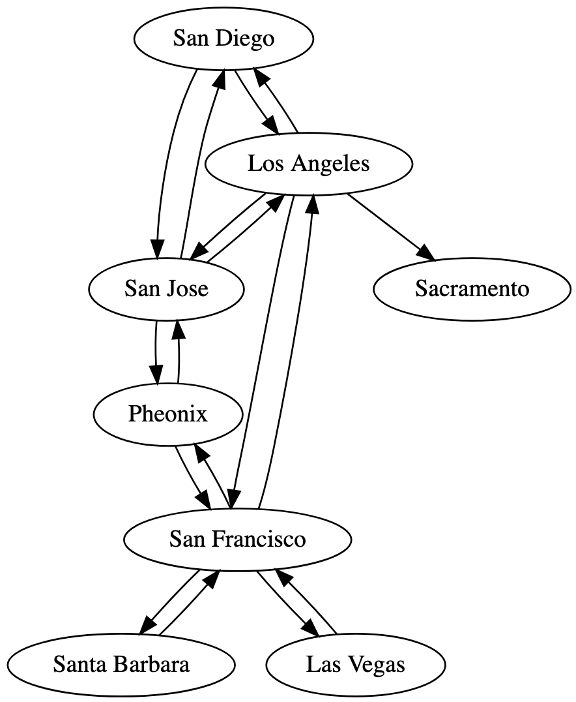
Homework 2 Review - flights
Notes:
San Francisco -> Los Angeles
everything in the left subtree is smaller than the right.

Slide 15
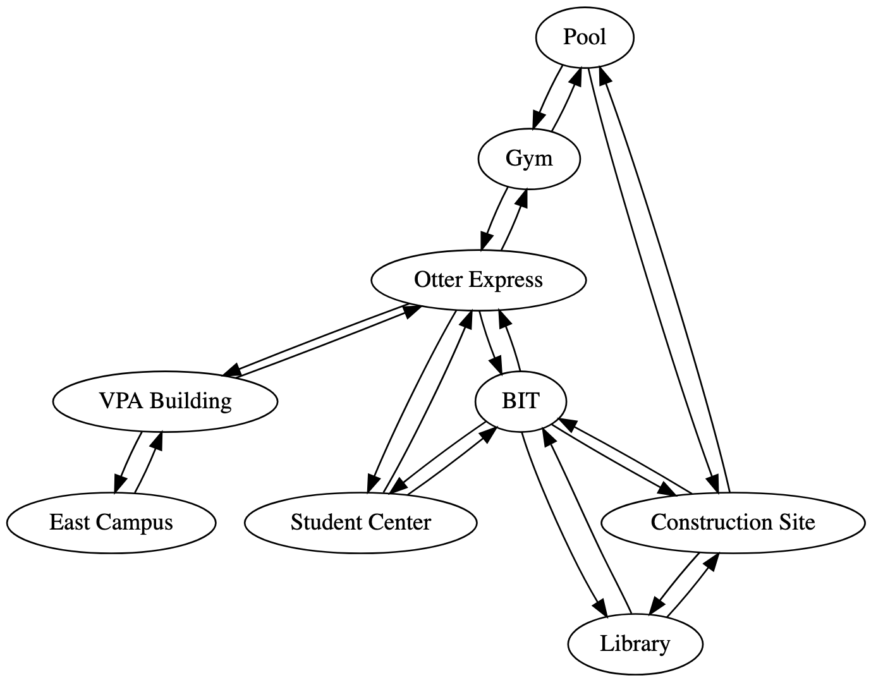
Homework 2 Review - campuswalk
Notes:
BIT -> East Campus

Slide 16
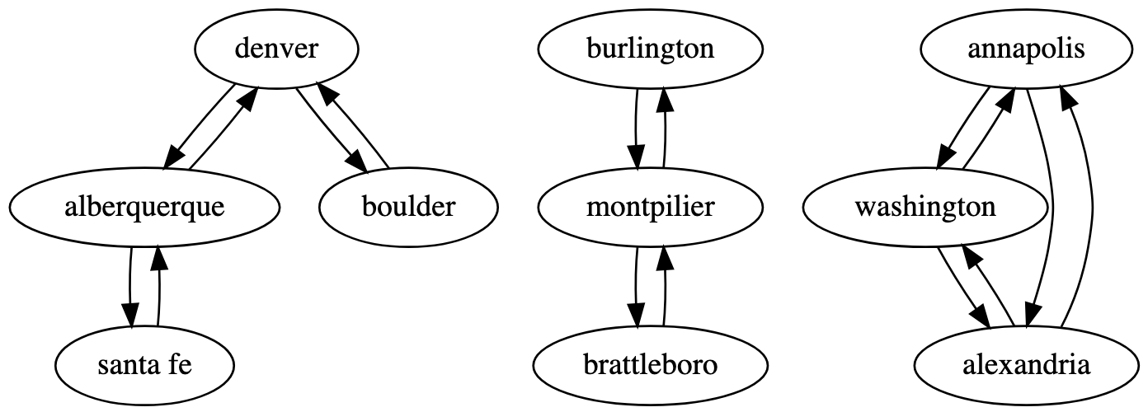
Homework 2 Review - trains

Slide 17
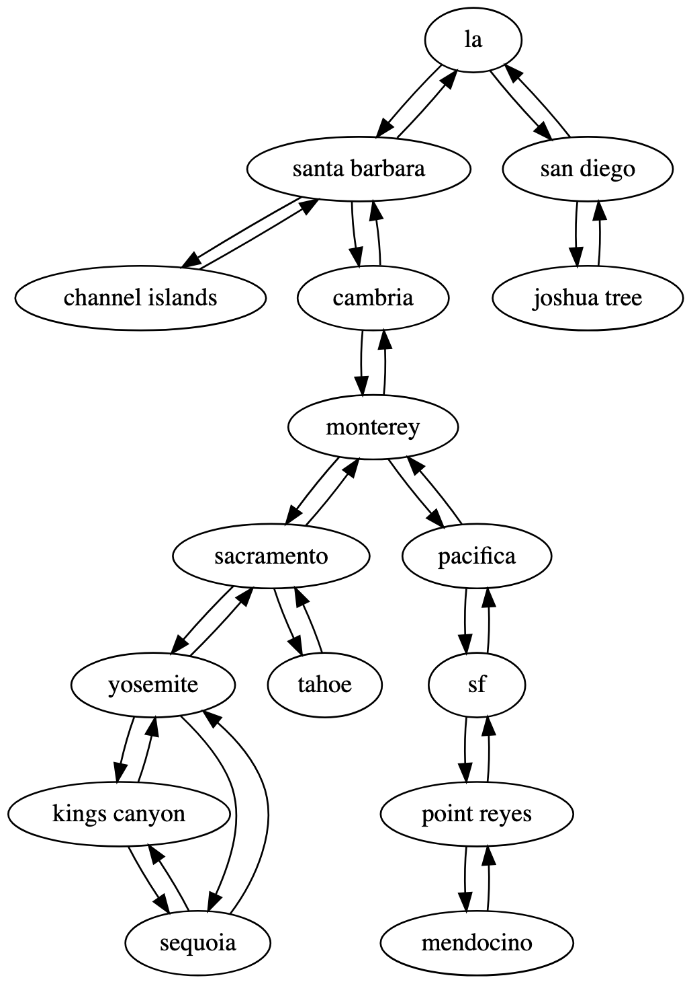
Homework 2 Review - roadtrip
Notes:
2
Monterey

Slide 18
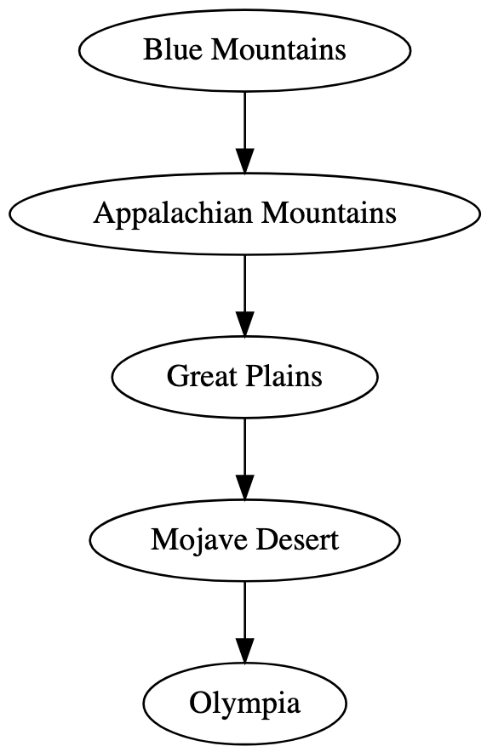
Homework 2 Review - species

Slide 19
Homework 2 Review - aliens
6
caf
eca
eae
eab
eeb
eef

Slide 20
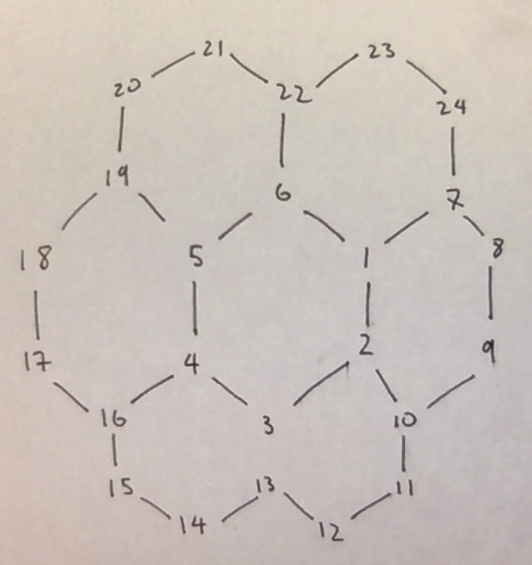
Homework 2 Review - catan
Notes:
3 - distance away
4 - settlement num
1
2
5
22

Slide 21
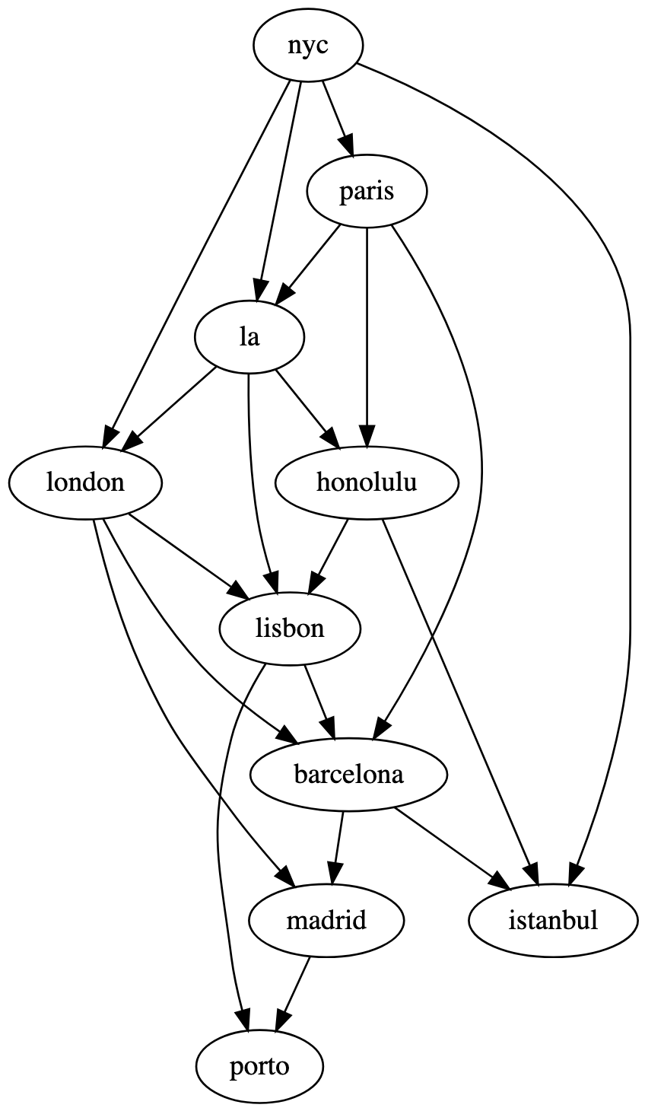
Homework 2 Review - euroish

Slide 22
Homework 1 Review -
Notes:
Another special tree is the Binary Search Tree.
everything in the left subtree is smaller than the right.

Slide 23
Break!
Notes:
Another special tree is the Binary Search Tree.
everything in the left subtree is smaller than the right.

Slide 24
Reflection Lab
Fill out and turn in reflection worksheet.
Homework problems: “S19.L13.Reflect” in iLearn.
Password: goldfish
Exam: Correct your own exam on another sheet of paper and turn in to get up to 30% of lost points back.
For each problem state what your mistake was in addition to the correction.
Notes:
Another special tree is the Binary Search Tree.
everything in the left subtree is smaller than the right.

